Slide 1
S24CS7.602: Topics in Deep Learning
Project Progress 2
April 15, 2024

Slide 2
VerFedGNN: A Privacy-Preserving Federated Graph Neural Network for Recommender Systems
Team MR. VR
Mayank Shukla| Rishabh Jain| Vaibhav Tomar| Rishabh Srivastava

Slide 3
Problem Statement
Our study proposes the first vertical federated GNN-based recommender system, called VerFedGNN. We design a framework to transmit:
the summation of neighbor embeddings using random projection, and
gradients of public parameter perturbed by ternary quantization mechanism.
This paper studies the vertical federated setting in which multiple collaborating recommenders offer different items to the same set of users. In addition, FedPerGNN expands the local user-item graphs with anonymous neighbouring user nodes to perform embedding propagation, which could leak users’ interaction information

Slide 4
Problem Statement
We assume that P parties collaboratively train a recommender system, where each party holds a set of common users but non-overlapping items.
Denote U = {u₁, u₂, ..., u_{N}} as the set of common users and V_{p} = {v₁, v₂, ..., v_{Mp}} as the set of items for party p. The total item size M_{p}, p ∈ [1, P] is shared across parties.Assume that user u has N_{u} neighbouring items N(u) = {v₁, v₂, ..., v_{Nu}}, and item v has N_{v} neighbouring users N(v) = {u₁, u₂, ..., u_{Nv}}.
Denote N_{p}(u) = {v₁, v₂, ..., v_{Nu}}, as the neighbouring items for user u in party p. The related items and users form a local subgraph G_{p} in party p.
Denote r_{uv} as the rating user u gives to item v. Our objective is to generate a rating prediction that minimizes the squared discrepancy between actual ratings and estimate.

Slide 5
Timeline and Next Steps
 | Task | Tentative Date
Phase One | Setting up the environment and running available code for Federated Recommender System. | 14th March
Phase Two | Implementing VerFedGNN | 15th April
Phase Three | Evaluation and Analysis | 25th April

Slide 6
Progress(March 14)
Dataset: We use two benchmark datasets for recommendation, MovieLens-1M2 (ML-1M) and BookCrossing3. For BookCrossing we randomly select 6000 users and 3000 items. The items are divided into non-overlapping groups to simulate the vertical federated setting.
We have set up the environment for the VerFedGNN. Also, the code for Federated Recommender System was available online which we have re-implemented and run.

Slide 7
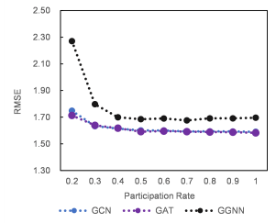
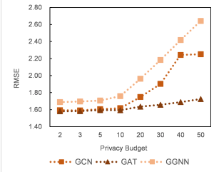
Progress(April 15)
We have implemented the VerFedGNN model proposed by the paper.
We also did hyperparameter studies, by varying important parameters for book crossing dataset.

Slide 8
Next Steps
Compare our model with other available models, like FedSage and CentralGNN and do a comparative study.
Provide a novel contribution.

Slide 9
THANK YOU

